Slide 1


Review-II
Low Power RTL Design using clock gating
AY 2025-26
Capstone Project – Introduction (PROJ2999)
GITAM (Deemed-to-be) University
Department of Electrical Electronics and Communication Engineering
Project Team:
    Nukala Naga Jyoshika – BU22EECE0100489
    Poojala Renuka – BU22EECE0100491
    Md. Sameena Thasleem – BU22EECE0100497
Project Mentor:
Shatadal Chatterjee
Project In-charge:
Kshitij Shakya
www.gitam.edu

Slide 2
Objective and Goals
Objective
Brief Description:
The main objective of this project is to lower the power utilized by the circuit in RTL design by using clock gating method. Beyond basic clock gating system, the design aims to manage multiple power saving techniques from a single centralized controller to maximize energy efficiency. It is a unified adaptive system that manages both clock gating and dynamic frequency scaling from a single controller.
The main advantage of this system is it can save the power based on the circuit’s activity.
Goals
Main Goals:
The main goal is to reduce the power consumption in the circuit.
The primary goal is to create a single, centralized controller that uses for both power saving methods: clock gating and dynamic frequency scaling. This is more efficient than using separate controllers for each functions.
Developing the adaptive system that monitor the circuit activity, whether it is in active mode or in idle mode
Project aims to showcase a real-world, standard approach to low power design.

Slide 3
Project Plan (Clearly mention milestone for objectives under each reviews)
Review 1: Project Proposal & Design
Define the project scope and propose the high-level design.
Milestones:
Research and summarize existing low-power design techniques, including clock gating and frequency scaling.
Clearly define the issue of power consumption in RTL circuits.
Outline the project's objectives, goals, and methodology.
Review 2: Unified Controller on a Full Adder
To combine multiple power-saving techniques under a single, advanced controller to achieve maximum energy efficiency.
Your controller now manages both clock gating (for light sleep) and frequency scaling (for deep sleep) based on the duration of inactivity. This is the unified adaptive system we've been working on. And applied this on full adder.
This is where we saw 50.3% power reduction compared to basic clock gating, including the significant power reduction numbers and the functional waveforms that validate your Light Sleep and Deep Sleep modes.
Review 3: Unified Controller on Baugh Wooley
And next we applied our unified adaptive system on little more complex circuit called Baugh Wooley multiplier.
Here we saw 68.6% reduction of power when the unified adaptive system algorithm is applied on Baugh Wooley multiplier and compared to basic clock gating on Baugh Wooley.

Slide 4
Literature Survey
Key Publications
Power Reduction Through RTL Clock Gating[1]
Validated a design methodology for reducing ASIC power using RTL clock gating.
Proved that RTL clock gating can reduce dynamic current consumption by 72%( 280mA to 78mA) on a real world 200K=gate ASIC.
The technique was most effective at reducing power from flipflops, achieving an 80% reduction from that area.
Found that RTL clock gating resulted in significant 6.75 cell area savings by eliminating multiplexers.
Enhanced clock gating technique for power optimization in SRAM and Sequential circuit.[2]
This paper proposes enhanced clock gating technique using D latch and a buffer to reduce power consumption.
It aims to solve common issues like glitching and clock triggering found in traditional clock gating.
The proposed logic achieves a power consumption of 1.065W and a delay of 6ns on a sequential circuit.
This is significant improvement over a traditional 4-bit counter without clock gating which has power of 22.96W and a delay of 72ns.
Implementation of adaptive clock gating technique for Low power circuits – A Review[3]
This paper reviews various clock gating methods and concludes that adaptive clock gating is the most robust technique.
It compares latch based, flip flop based and gate based clock gating, finding the gate based method is most efficient.
Case study showed that a power reduction of 21.5% in random flipflop design and 6% in 3-bit counter.
It concludes that the amount of power reduction varies depending on system’s specific activity and logic.

Slide 5
Key Resources – Whitepaper| Application Notes | Datasheet| Others
Artix – 7 datasheet
Existing Implementations – Products| Opensource| GitHub etc
1. Gate based clock gating:
This is one of the simplest and most efficient clock gating techniques, where a logic gate (such as an AND, OR, or NOR gate) is used to control the clock signal. The design is simple and has less area occupied
2. Latch-based clock gating:
This technique uses a level-sensitive latch as the controlling element for the clock. It avoids glitches and has a good performance, but it has a long sleep period and can cause a mismatch in delay.
3. Flip-flop based clock gating:
This method uses an edge-triggered flip-flop to control the clock enable pin. Flip-flop based gating is not highly preferred due to high power consumption, high switching activity, and large area usage.
4. Synthesis-based clock gating:
This is widely used method where EDA tools automatically insert clock gating to reduce clock pulses. It is easy to implement and has less timing constraints, but it can have a high redundant problem and consume more power compared to other techniques.

Slide 6
5. Data-driven based clock gating:
This technique blocks the clock signal in the next cycle by XOR-ing the current data output with the present data input. It consumes less power, avoids the redundant problem, and has moderate switching activity, but its implementation is difficult.
6. Auto-gated clock gating:
This method uses an auto-gated flip-flop for the design. It is easy to implement and has a less redundant problem, but it has high switching activity and high timing constraints. It only gates the slave latches and not the remaining clock loads.
7. Look-ahead based clock gating:
Similar to data-driven gating, this technique can stop most redundant clock pulses. It is preferred for its ability to avoid tight timing constraints and its easy circuit implementation. It also consumes less power and has less switching activity.

Slide 7
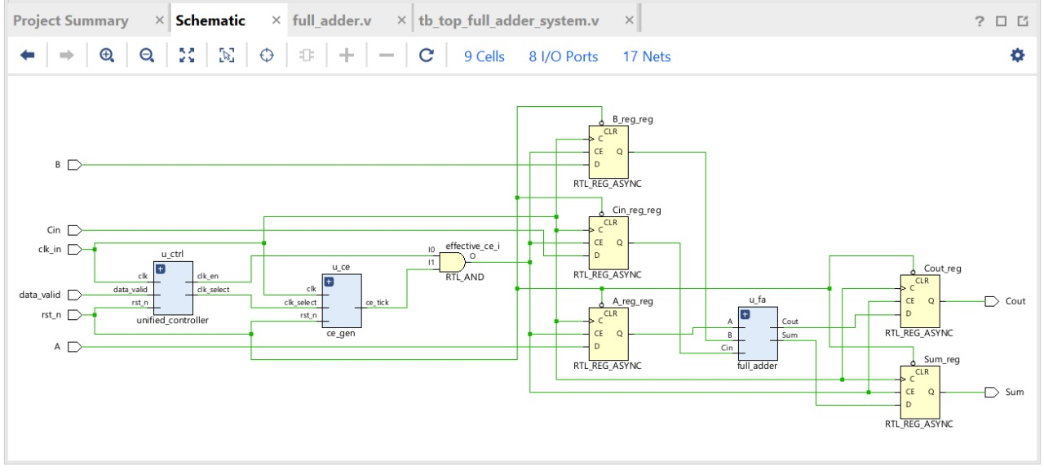
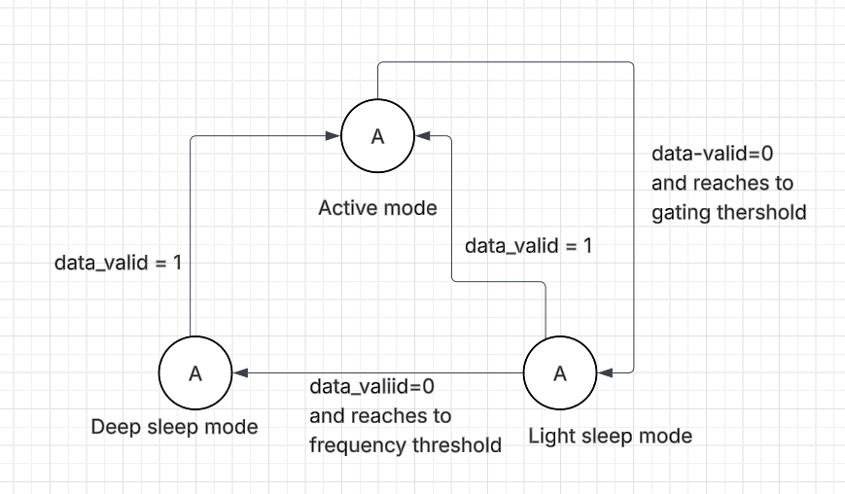
Architecture
Structural Diagram
Block Diagram
Behaviour Diagram
Flow chart/ State machine
Resource - https://www.lucidchart.com/pages/examples/uml_diagram_tool
State machine diagram – shows the transitions of unified adaptive clock gating
Schematic diagram of full adder using unified adaptive clock gating

Slide 8
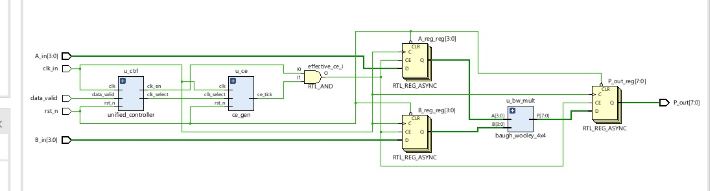
Schematic diagram of Baugh Wooley using unified adaptive clock gating

Slide 9
Use Cases & Testing
Use Cases
Use Case 1: Active Operation
System continuously receiving valid data and performing computations
The goal is to verify that the full adder performs its function correctly and that the power-saving modes are not triggered.
Use Case 2: Short Idle Period
The system becomes idle for short period of time.
The goal is to verify that the controller enters into light sleep mode by gating the clock and holds the last valid output.
Use Case 3: Long Idle Period
The system remains idle for long duration.
The goal is to verify that the controller enters into deep sleep mode by scaling down the clock frequency, and holds the last valid output.
Test Cases
Test Case 1: Active Mode Validation
To confirm the full adder performs its calculations accurately when the system is active.
For this case keep the data_valid signal as high and apply the sequence of changing inputs.
The Sum and Cout outputs will update correctly with a small delay after each input change.
Test Case 2: Light Sleep / Gating Validation
To show that the system correctly gates the clock and holds its outputs during a short idle period.
For this case keep the data_valid signal as low.
The Sum and Cout outputs hold their last valid values and do not change
Test Case 3: Wake-Up Validation
To prove that the system can transition back to Active Mode and continue processing data correctly
After the sleep mode data_valid is again high.
The Sum and Cout outputs will update correctly based on the new inputs.

Slide 10
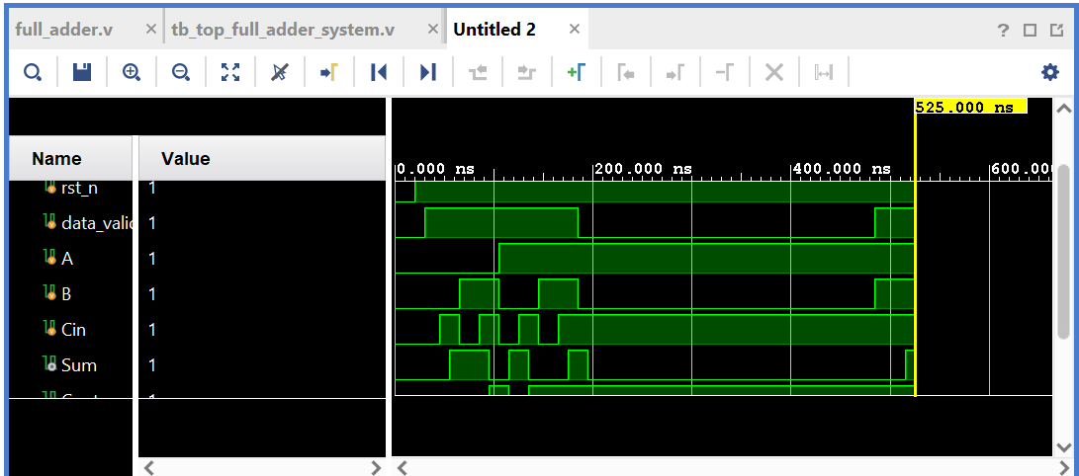
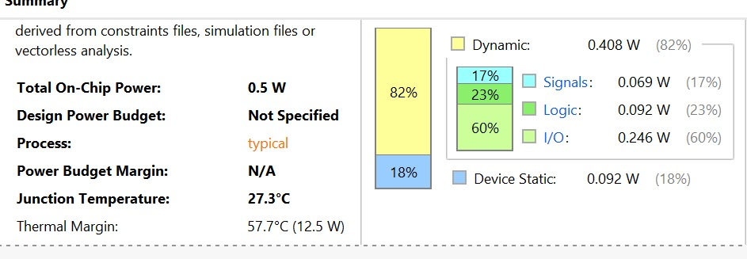
Implementation and Results – Iteration 1
Iteration : Results of Full Adder
Unified adaptive clock gating
The unified_controller and ce_gen work together to produce a single, highly-controlled effective_ce signal. This signal is used to directly control the enable pin on each individual register, giving you granular control over exactly which parts of the circuit are clocked.

Slide 11
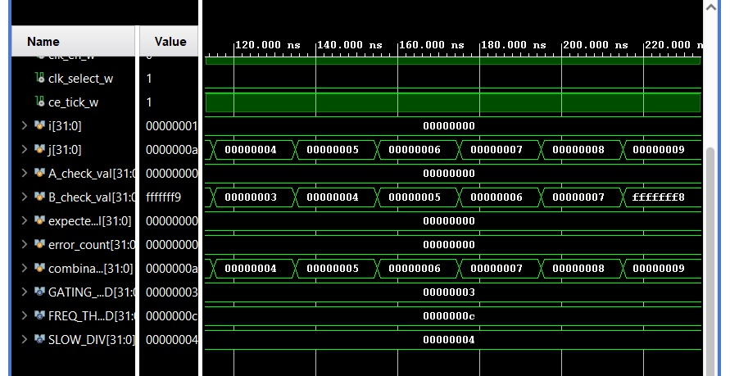
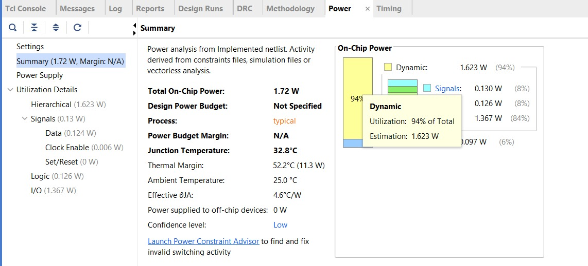
Implementation and Results – Iteration 2
Iteration : Results of Baugh Wooley
Wave form
Block Diagram
Power Report

Slide 12
Conclusion & Future Work
Summary and Conclusion
In this project, we successfully introduced and implemented a smart, two-level power-saving system called a "unified adaptive clock gating methodology."
Our design uses a single controller that intelligently manages two distinct energy-saving tools: clock gating and dynamic frequency scaling.
The results proved that the functionality of the full adder circuit was not impacted by this algorithm.
The design successfully reduced the total power reduction compare to basic clock gating is 50.3% in full adder and 68.6% in Baugh Wooley, demonstrating the efficiency of our approach.
This project shows that a unified, adaptive strategy is a highly effective method for low-power RTL design.
Future Work
Implement in Advanced Computing Blocks: The unified approach can be applied to more complex computing blocks to further demonstrate the efficiency and scalability of the proposed technique.
Dynamic Voltage and Frequency Scaling (DVFS): Extend the controller to manage not only clock frequency but also the core voltage. This would lead to a quadratic reduction in power, achieving even greater energy savings.
Application to a Larger System: Apply the controller to a more extensive, multi-module system to verify its effectiveness and robustness in a real-world, System-on-Chip (SoC) environment.

Slide 13
References
[1] Frank Emnett and Mark Biegel ,“Power Reduction Through RTL Clock Gating“ SNUG San Jose 2000
[2] C. Ashok Kumar, B.K. Madhavi, K. Lal Kishore ,Journal of Automation, Mobile Robotics and Intelligent Systems “Enhanced clock gating technique for power optimization in SRAM and Sequential circuit”, 1th October 2021
[3] 1SHREYA MAOLANKER, 2SWAPNIL BORPE, 3BHAGYASHREE KALMEGH, 4NIKHIL PARKHI, 5SAURABH GIRATKAR , “Implementation of adaptive clock gating technique for Low power circuits – A Review”, International Journal of Electrical, Electronics and Data Communication, ISSN: 2320-2084
[4]H. Vo, "The Merged Clock Gating Architecture For Low Power Digital Clock Application On FPGA," 2018 International Conference on Advanced Technologies for Communications (ATC), Ho Chi Minh City, Vietnam, 2018, pp. 282-286, doi: 10.1109/ATC.2018.8587596.
[5]M. Cho, B. Gill, R. Sharma and S. Gupta, "Adaptive Clock Gating for Improving Wear out induced Duty Cycle Shift in the Clock Network," 2024 IEEE International Reliability Physics Symposium (IRPS), Grapevine, TX, USA, 2024, pp. 1-4, doi: 10.1109/IRPS48228.2024.10529398.
[6]J. Shinde and S. S. Salankar, "Clock gating — A power optimizing technique for VLSI circuits," 2011 Annual IEEE India Conference, Hyderabad, India, 2011, pp. 1-4, doi: 10.1109/INDCON.2011.6139440.
[7] T. Chindhu S. and N. Shanmugasundaram, "Clock Gating Techniques: An Overview," 2018 Conference on Emerging Devices and Smart Systems (ICEDSS), Tiruchengode, India, 2018, pp. 217-221, doi: 10.1109/ICEDSS.2018.8544281.

Slide 14
[8] S. Panda, S. Sharma and A. R. Asati, "Clock Gating Analysis of TG Based D Flip-Flop for Different Technology Nodes," 2020 IEEE 7th Uttar Pradesh Section International Conference on Electrical, Electronics and Computer Engineering (UPCON), Prayagraj, India, 2020, pp. 1-6, doi: 10.1109/UPCON50219.2020.9376565.
[9] G. S. R. Srivatsava, P. Singh, S. Gaggar and S. K. Vishvakarma, "Dynamic power reduction through clock gating technique for low power memory applications," 2015 IEEE International Conference on Electrical, Computer and Communication Technologies (ICECCT), Coimbatore, India, 2015, pp. 1-6, doi: 10.1109/ICECCT.2015.7226204.
[10] K. V. S. S. Aditya, B. B. Kotaru and B. B. Naik, "Design of low power shift register using activity-driven optimized clock gating and run-time power gating," 2014 International Conference on Green Computing Communication and Electrical Engineering (ICGCCEE), Coimbatore, India, 2014, pp. 1-7, doi: 10.1109/ICGCCEE.2014.6922241.
[11] B. P. S. Tomar, V. Chaurasia, J. Yadav and B. Pandey, "Power Reduction of ITC'99-b01 Benchmark Circuit Using Clock Gating Technique," 2013 5th International Conference and Computational Intelligence and Communication Networks, Mathura, India, 2013, pp. 423-427, doi: 10.1109/CICN.2013.93.
[12] S. Gupta and M. Vinodhini, "Low-Power Linear Feedback Shift Register Using TSPC Flip-Flop and Clock Gating," 2025 Fifth International Conference on Advances in Electrical, Computing, Communication and Sustainable Technologies (ICAECT), Bhilai, India, 2025, pp. 1-5, doi: 10.1109/ICAECT63952.2025.10958909.
[13] J. R, M. M, G. D. B and M. A. H, "Optimized Design of Clock-Gated D Flip-Flop using Transmission Gate," 2025 Third International Conference on Augmented Intelligence and Sustainable Systems (ICAISS), Trichy, India, 2025, pp. 911-916, doi: 10.1109/ICAISS61471.2025.11042123.

Slide 15
THANK YOU
Have a Great Day !

